Slide 1

RAVEN: Improving Interactive Latency for the Connected Car
HyunJong (Joseph) Lee†, Jason Flinn†, and Basavaraj Tonshal⏀
University of Michigan†, Ford Motor Company⏀

Slide 2
Vehicles are connected over many networks

Slide 3
The connected car is a hotspot

Slide 4
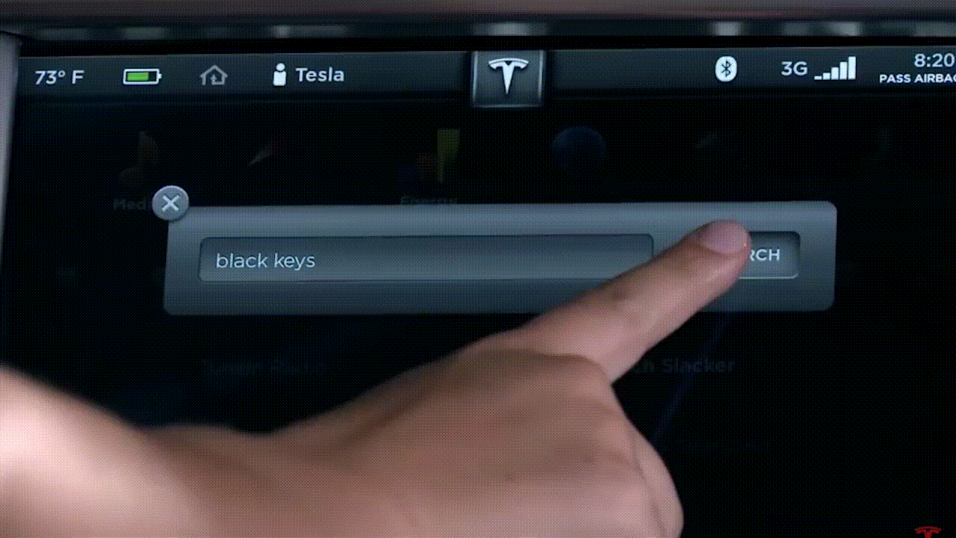
Apps perform poorly in vehicle
Apps in vehicle perform poorly
These apps are latency-sensitive
Wireless networks in vehicle:
Significant variation in latency
Extremely unpredictable tail latency

Slide 5
Uncertainty in prediction for multi-network
RTT
RTT

Slide 6


Uncertainty in prediction for multi-network
Benefit: redundancy reduces latency under uncertainty
Cost: increased resource usage
Strategic redundancy balances benefit & cost
RTT
3
2
1
3
2
1
3
2
1
RTT

Slide 7
Overview
Study of current wireless network connectivity in vehicle
Design and implementation of RAVEN
Employs strategic redundancy
Evaluation
Emulation
Live vehicle experiments

Slide 8
Study of vehicular networking
Measure network RTT of 3 networks simultaneously
Scenarios: downtown, highway, rural area, suburban

Slide 9
RTT distributions for 3 networks
Different networks have different distributions
Commercial WiFi offers good performance
Tail latency is extremely high for all networks

Slide 10
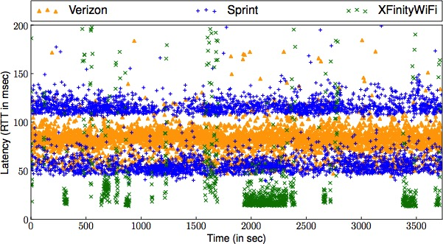
RTT variation
Latency variation is high and unpredictable
Given network remains best network is 2 seconds in median

Slide 11
Study of vehicular networking: summary
Different networks have different distribution
Wireless networks in vehicle exhibit extremely high tail RTT
In short term, RTT is very unpredictable
Uncertain which network offers the best RTT at given time

Slide 12
Overview
Study of current wireless network connectivity in vehicle
Design and implementation of RAVEN
Employs strategic redundancy
Evaluation
Emulation
Live vehicle experiments

Slide 13
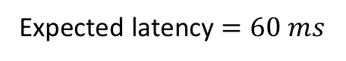
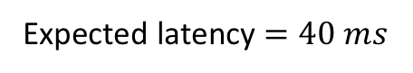
Solution to multi-networks: MPTCP
$${Expected}_{i}=α{Expected}_{i−1}+\left(1−α\right){Measured}_{i−1}$$
Expected latency $=40 ms$
7
6
5
4
3
2
1
7
6
5
4
Expected latency $=60 ms$
MPTCP missed important opportunity
by not employing redundancy

Slide 14
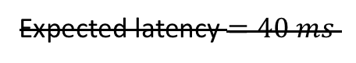
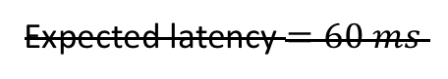
Moving expected latency to distribution
RTT
Expected latency $=40 ms$
Expected latency $=40 ms$
Expected latency $=60 ms$
Expected latency $=60 ms$
RTT

Slide 15
Embracing uncertainty
Strategic redundancy
1
RTT
RTT
Send redundantly over networks
with confidence intervals overlap
RTT

Slide 16
Tunable knob: % of confidence interval
2
2
RTT

Slide 17
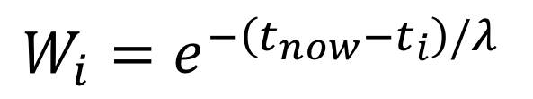
How to estimate RTT with stale samples?
$$W_{i}=e^{−\left(t_{now}−t_{i}\right)/λ}$$
$${Expected}_{i}=α{Expected}_{i−1}+\left(1−α\right){Measured}_{i−1}$$
time
Time-based weight accounts for
recency of samples
Order-based weight does not account for stale samples

Slide 18
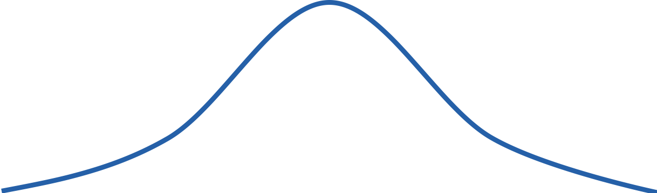
Temporarily poor performing network
RTT
3
2
1
RTT

Slide 19
Replacing active probing with aging
2
2
RTT

Slide 20
How to identify latency-sensitive traffic?
Problem: should only use redundancy when it matters
Prior systems require apps to disclose size, importance:
DEMS, Intentional Networking, ...
RAVEN automatically identifies traffic
Small transfers likely to be RTT-sensitive ➔ redundancy
Large transfers not impacted much by RTT ➔ implies striping

Slide 21
In the paper
In kernel implementation of MPTCP scheduler
Cancels work that becomes useless
Details of algorithm

Slide 22
Overview
Study of current wireless network connectivity in vehicle
Design and implementation of RAVEN
Employs strategic redundancy
Evaluation
Emulation
Live vehicle experiments

Slide 23
Speech recognition in emulation
TCP over all networks have high tail latency

Slide 24
Speech recognition in emulation
RAVEN improves median latency up to 30% over MPTCP
RAVEN reduces tail latency up to 5x over MPTCP

Slide 25
Speech recognition in live experiment
RAVEN improves median up to 80% over MPTCP in live
RAVEN reduces tail latency up to 2x over MPTCP in live

Slide 26
Yelp in live experiment
5x
RAVEN improves median latency by 5x for Yelp in live
MPTCP interacts poorly with power management (PM)

Slide 27
Effectively identify latency-sensitive traffic
Application | Redundant %
File Download (1K) | 100 %
Web Browsing | 4.90 %
File Download (1M) | 1.27 %
Application Install | 0.59 %
Video Streaming | 0.03 %
Small transfer, all data are sent redundantly
Large transfer, first a few bytes are sent redundantly

Slide 28

Conclusion
Cars are connected to infrastructure over multiple networks
Apps used in vehicle are latency-sensitive
Wireless networks in vehicle have unpredictable, poor latency
RAVEN is a MPTCP scheduler that employs strategic redundancy to hedge a bet against uncertainty
VNperf & traces available at http://vnperf.github.io

